Slide 1
Enhancing Asset Management Strategies: Leveraging Machine Learning for Customer Transaction Prediction

Slide 2
About Me
Driven by a passion for data science and AI, leveraging ML practices to drive business success.
Profession Experience :
Data scientist with 7+ years of experience across BFSI and marketing.
Skills :
Predictive modeling, data analytics, machine learning algorithms, and data visualization.
Education :
Bachelors in engineering in electronics and telecommunication.

Slide 3
Context Setting
Background :
This case study is a part of interview process where I was asked to identify which customers will make a specific transaction in future, irrespective of the amount of money transacted.
Objective :
Objective of this case study is to show case how we can leverage machine learning to enhance asset management strategies by predicting customer transaction.

Slide 4
Use Cases
Here are the top three problems that predicting customer transactions can help solve for an asset management firm
Personalized Client Engagement
Effective Marketing Strategies
Enhanced Risk Management
By accurately predicting whether a client will make a specific transaction, Clients receive opportunities that align with their preferences, leading to more meaningful interactions with the firm.
Transaction prediction can help focus on clients who are more likely to undertake specific transactions. This increases the efficiency of marketing efforts, leading to higher conversion rates and better utilization of marketing resources.
Predicting customer transactions aids in identifying high-risk transactions or clients. If a transaction is predicted that involves a higher level of risk, the firm can take proactive measures to manage that risk.

Slide 5
Putting Ideas into Action: The Machine Learning Process
Business Understanding
Data Acquisition
Data Exploration
Data Preprocessing
Data Modelling
Deployment
Monitoring
Alignment of business goals with machine learning goals
Crafting Features, Choosing Models, Training Models, Tuning Parameters, Evaluating Performance and Interpreting Results
Cleaning and transforming data into suitable format for analysis
Ongoing monitoring of model performance to consistently achieve desired outcomes
Collection of relevant data sources including customer behaviour, transaction history, product behaviour and demographics
Potential pattern and trend identification which may further lead to feature engineering
Deploying Model into production so that it can make predictions on new and unseen data

Slide 6

Data Landscape
/
%
200K
Customers
200 + 214
Features
80:20 Data Split
10.05%
Transactions made
#1
The data's descriptive statistics reveal notable diversity in standard deviation ranging from 0.007 to 21
#2
The data was devoid of any missing values. Additionally, there were no instances of high correlation, nor were there variables with zero variance.
#3
After examining all variables in both the training and test datasets, no significant distribution differences were observed. This assures that the training data reliably represents the test data
Data Description
Feature Engineering Techniques Used
2nd approach was to create features containing values transformed using Weight of Evidence (WOE) for all features, along with the features’ descriptive statistics. This aids the model in capturing the predictive power of variables and enhancing its ability to distinguish between different customer transaction behaviors.
1st approach involved generating descriptive statistical features—such as mean, median, minimum, maximum, standard deviation, kurtosis, and skewness—for each customer. By incorporating these features, the model gains a comprehensive understanding of each customer's transactional profile

Slide 7
Model Training Workflow
Data Splitting
Model Selection
Feature Selection
Hyperparameter Tuning
Model Validation
The train data was split randomly into 80% for training and 20% for validation. This split was done in a way that both datasets had the same percentage of the target variable, ensuring a balanced representation.
Three models were trained using all 214 features, and Light GBM model exhibited the highest AUC ROC score on validation dataset, thus was chosen for further refinement.
I tested the impact of newly created features on model performance for feature selection. Since they didn't improve results, I retrained the LightGBM model using only original variables and selected final features based on model importance.
The RandomizedSearchCV algorithm was applied for hyperparameter tuning and cross-validation to mitigate overfitting of the base model. Additionally, LightGBM's "is_unbalance" parameter effectively handled class imbalance.
For model validation, the tuned model was used to score the test data, and the outcomes were submitted on Kaggle. The obtained results are outlined below.
Model Name | Training AUC | Validtn AUC
Logistic Regression | 0.8326 | 0.8367
XGBoost | 0.9821 | 0.866
LiGBM | 0.9251 | 0.8726
Data sample | AUC ROC score
Train | 0.9019
Validation | 0.8737
Test sample(Kaggle public score) | 0.86691
Test sample(Kaggle private score) | 0.86285
LiGBM | Training | Validtn
Before | 0.9251 | 0.8726
After | 0.9019 | 0.8737
Sample | #Customers
Training | 1,60,000
Validation | 40,000

Slide 8
Result Interpretation
To comprehend the model's outputs (transaction probabilities), we can categorize customers into n groups based on their probability of making a transaction. Each group contains an equal number of customers. These percentile bins can then guide us in making informed decisions.
Imagine a high-net-worth client with a history of investing in renewable energy projects. Using our ML-driven transaction predictor, we can anticipate their interest in new green initiatives. This enables personalized outreach, increasing engagement and strengthening client relationships.
Imagine another scenario where a traditionally conservative client suddenly adopts high-frequency, high-volatility trading. Our ML-driven transaction predictor identifies this shift, raising a risk alert

Slide 9
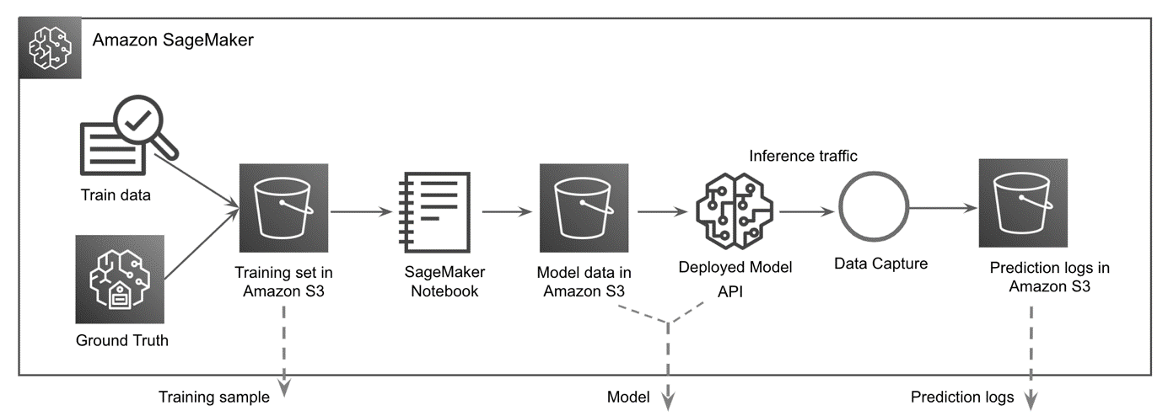
Model deployment and monitoring workflow

Slide 10
Questions & Answers

Slide 11
Thank you

